Slide 1
Covid 19- Analytics Dashboard Using IBM Cognos
PRESENTED BY:
TEAM NO: CSE-0014
18UK1A0537-NAGUNURI VIKAS
18UK1A0521-JANGA SPANDANA REDDY
18UK1A068-CHELUMALLA SHRAVYA
18UK1A0564-BATTULA SAISAMYUKTHA

Slide 2
OUTLINE:
INTRODUCTION
OBJECTIVE
IBM CLOUD
IBM CONGOS ANALYTICS
WORKING WITH THE DATASET
DATA VISUALIZATION CAHRTS
CREATING DASHBOARD
EXPORT THE ANALYSIS
CONCLUSION

Slide 3
INTRODUCTION:
Coronaviruses are a large family of viruses which may cause illness in animals or humans. In humans, several coronaviruses are known to cause respiratory infections ranging from the common cold to more severe diseases such as Middle East Respiratory Syndrome (MERS) and Severe Acute Respiratory Syndrome (SARS). The most recently discovered coronavirus causes coronavirus disease COVID-19 - World Health Organization.
The number of new cases are increasing day by day around the world. This dataset has information from the states and union territories of India at daily level.
As per this project we will be analyzing some important visualizations, creating a dashboard and by going through these we will get most of the insights of COVID 19 in India.

Slide 4
OBJECTIVE:
The number of new cases are increasing day by day around the world. This dataset has information from the states and union territories of India at daily level.
As per this project we will be analyzing some important visualizations, creating a dashboard and by going through these we will get most of the insights of COVID 19 in India.
By the end of this project, you will:
Know fundamental concepts and can work on IBM Cognos Analytics.
Gain a broad understanding of plotting different graphs.
Able to create meaningful dashboards

Slide 5
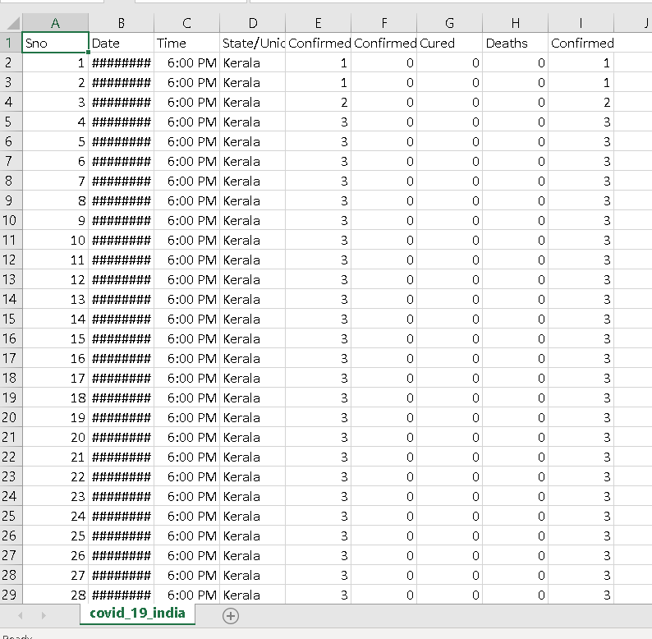
DATA:
Covid 19- Analytics Dashboard Using IBM Cognos
Dataset consists of:
It has 1,025 data points (rows) and 8 features (columns) describing the results of Covid
DATE
TIME
STATES/UNION TERRITORIES
CONFIRMED
CURED
DEATHS
FINALLY CONFIRMED
Data source: Internet

Slide 6
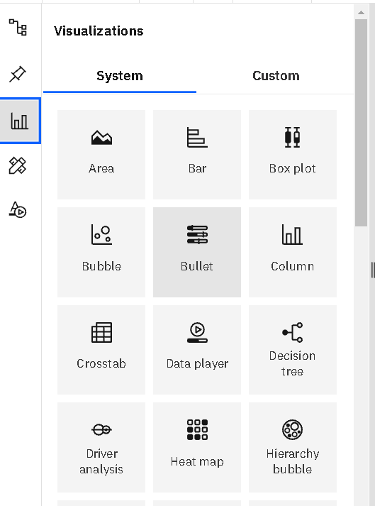
DATA VISUALISATION:
Data visualization is where a given dataset is presented in a graphical format. It helps the detection of patterns, trends and correlations that might go undetected in text-based data. Using the COVID 19 India dataset, we plan to create various graphs and charts to highlight the insights and visualizations.
To visualize the dataset we need IBM Congo's analytics Dashboard .These Dashboard contains Different Visualizations such as Area,Bar,Box plot,Bubble,Column,Dataplayer, Decision tree, Driver analysis,Heatmap,Hierarchy bubble etc.

Slide 7
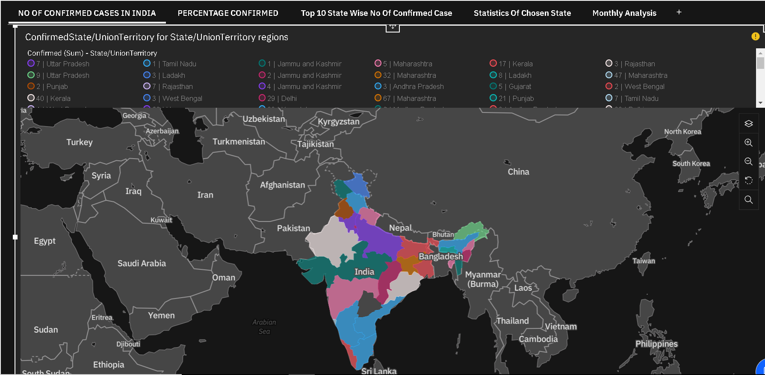
DATA VISUALIZATION CHARTS:
COVID 19 India Statistics:
NO OF CONFIRMED CASES:

Slide 8
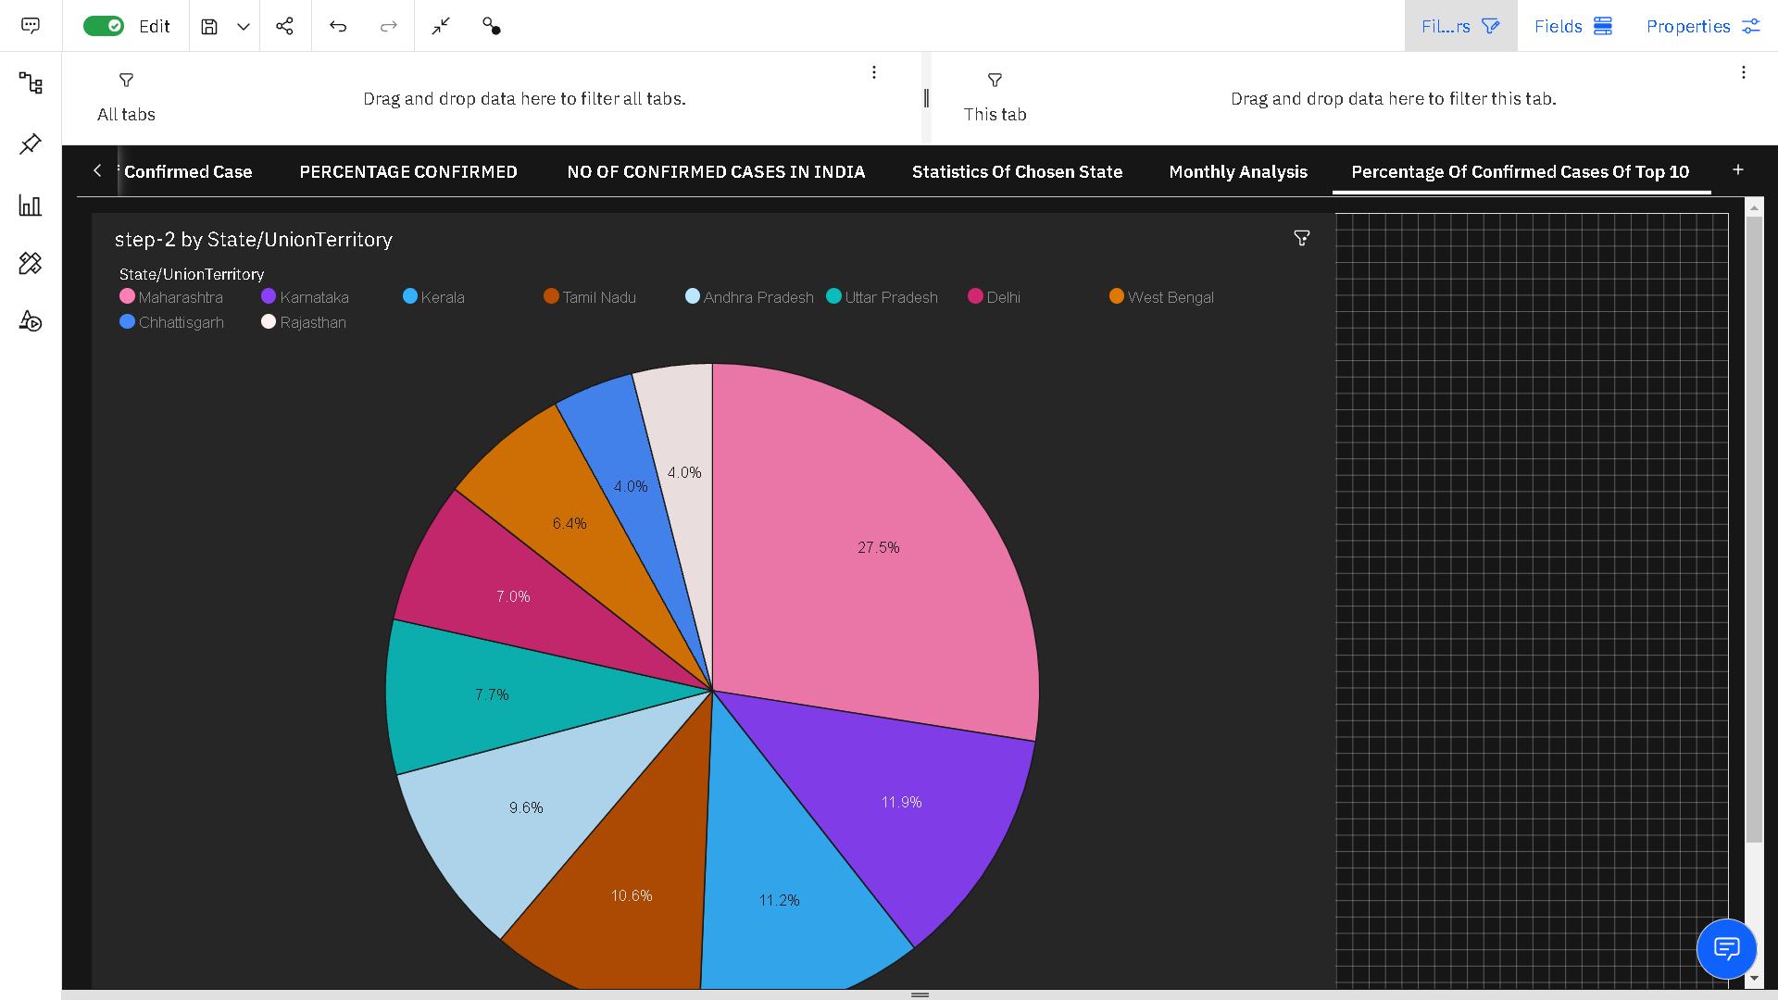
DATA VISUALIZATION CHARTS:
Percentage Of Confirmed Cases Of Top 10 Affected States:
In this visualization we will be concentrating on the percentage of no.of confirmed cases in top most states. We will be using the graph type- Pie.

Slide 9
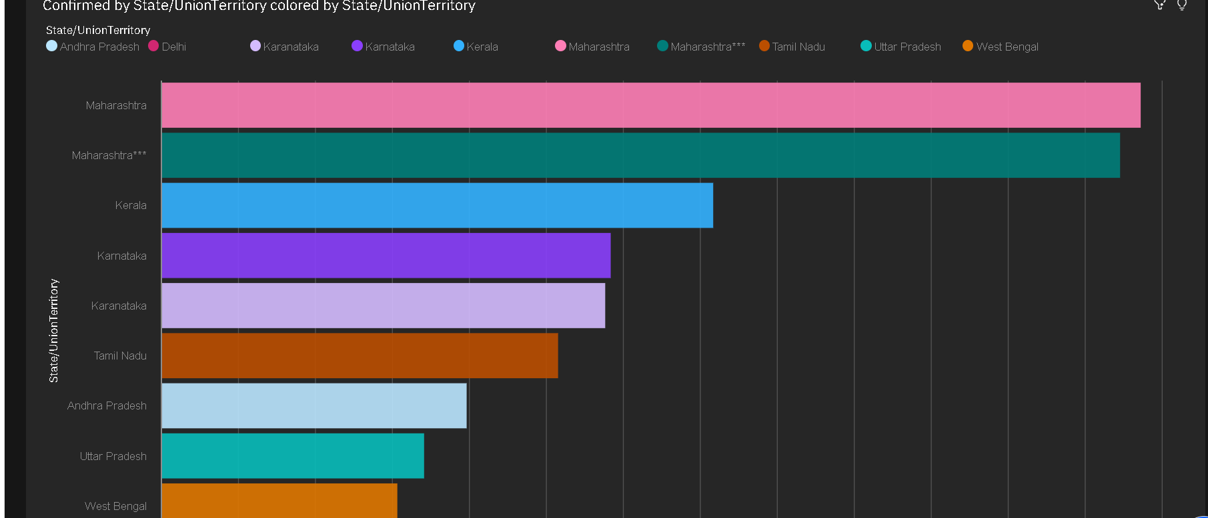
DATA VISUALIZATION CHART:
Top 10 State Wise No Of Confirmed Case:
In this visualization we will be concentrating on no.of confirmed cases in top most states but in descending order (starting from top most affected state). We will be using the graph type- Bar.

Slide 10
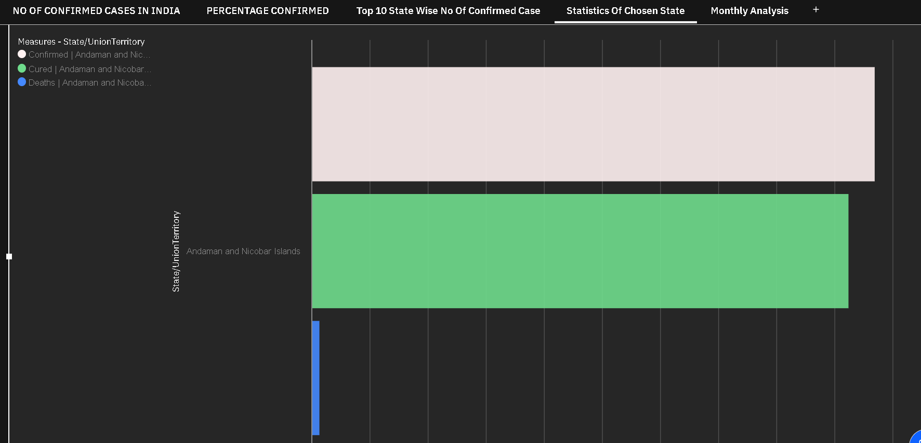
DATA VISUALIZATION CHART:
Statistics Of Chosen State(Selective State):
In this visualization we will be concentrating on no.of confirmed, cured as well as death cases in a particular state by applying filters. We will be using the graph type- Bar.

Slide 11
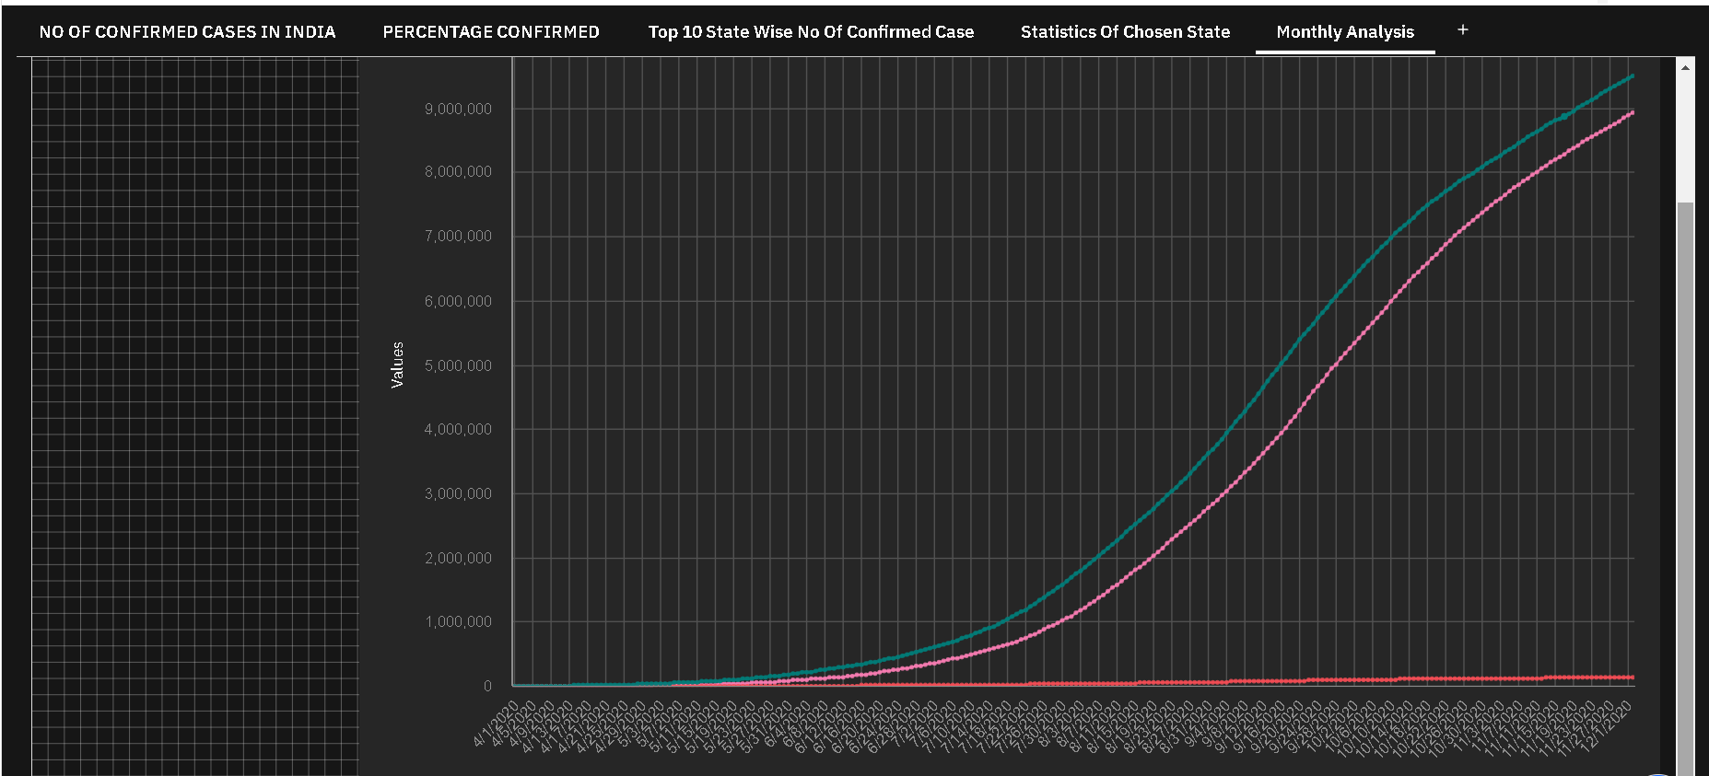
VISUALISATION OF GRAPHS:
Monthly Analysis:
In this visualization we will be concentrating on no.of confirmed, cured as well as death cases in a particular time period. This can be done by putting the DATE column in the filter and then selectinchoiceg the time period of our. We will be using the graph type- Line.

Slide 12
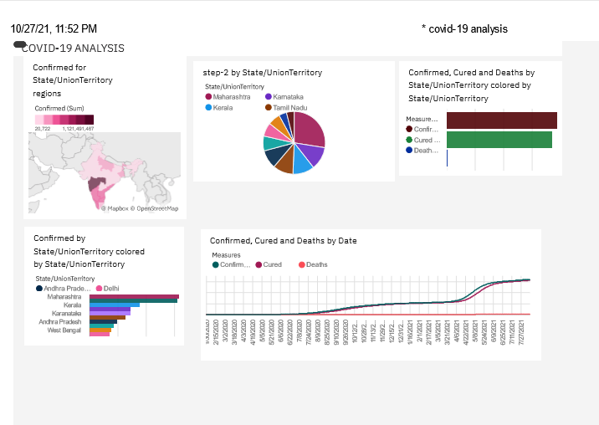
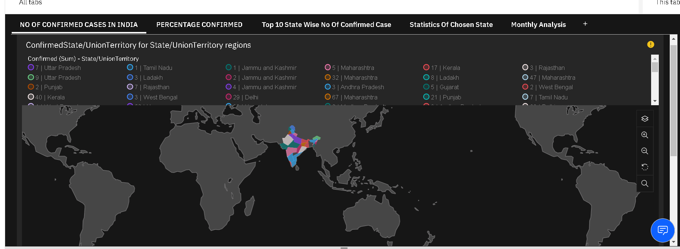
DASHBOARD CREATION:
Once you’ve created views on different tabs in Cognos analytics, you can pull them into a dashboard.

Slide 13
SOFTWARE REQUIREMENTS:
IBM Congo's Analytics Dashboard
IBM Account
Visualization tools: piechart,bars,bubble,bar-graph etc,,

Slide 14
CONCLUSION:
In this project we have presented that we will be analyzing some important visualizations, creating a dashboard and by going through these we will get most of the insights of COVID 19 in India.

